Slide 1
AI-Driven Multilingual Conversational Banking Assistant
E. RAMKISHORE, R. VAISHAVI
MENTOR : DR. R. Arthi rengaraj

Slide 2
SOLUTION
The proposed system is a multilingual voice-based banking interface that allows users to perform banking operations using simple voice commands in regional languages. Using advanced speech recognition and natural language processing, the system understands user queries, detects their intent, and securely executes actions such as balance inquiries, transaction checks, and fund transfers. The platform also provides real-time voice responses for a natural conversational experience. In addition, the AI performs emotion analysis on the user’s voice to detect stress, confusion, or urgency, allowing the system to respond more intelligently and provide better assistance. This solution improves accessibility for elderly users, rural populations, and individuals with limited digital literacy.

Slide 3
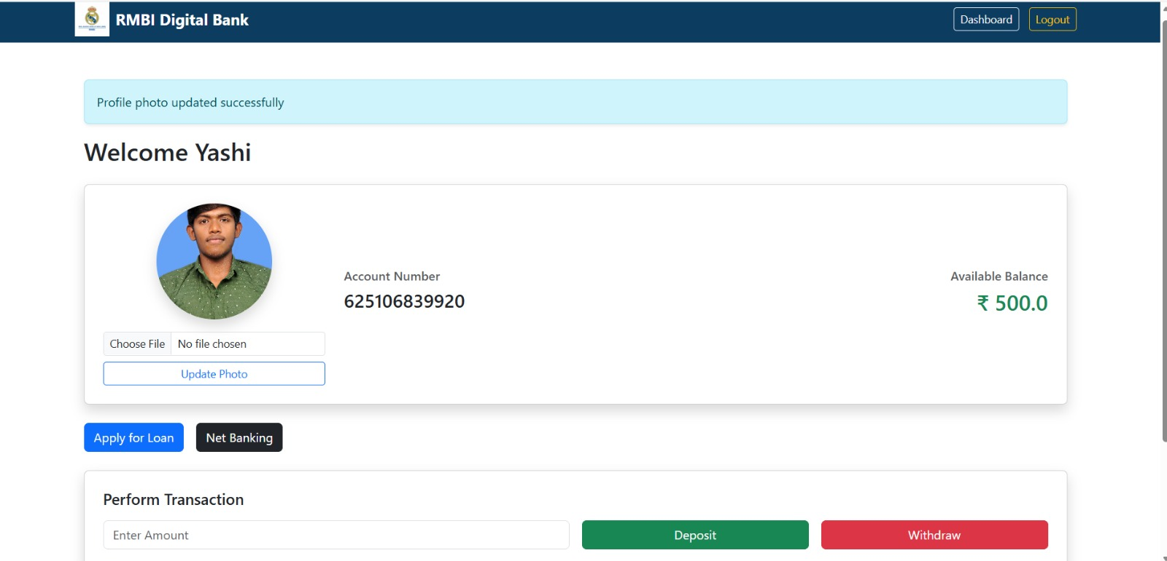
INNOVATION
Integrates multilingual voice interaction, allowing users to communicate with banking services in their preferred regional language.
Uses advanced AI and natural language processing to accurately understand user intent and process banking requests.
Incorporates emotion analysis, enabling the system to detect stress, confusion, or urgency from the user’s voice and respond more intelligently.
Provides a conversational AI experience that makes digital banking more natural and user-friendly compared to traditional app interfaces.
Combines voice recognition, emotion-aware AI, and secure banking automation into a single intelligent assistant.
Promotes inclusive digital banking by making financial services accessible to non-technical users, elderly individuals, and rural communities.

Slide 4
TECHNICAL APPROACH
USER CALL
EXOTEL VIRTUAL NUMBER
EXOTEL WEBHOOK TO FLASK BACKEND
BANK DATABASE (RMBI)
OPEN AI (INTENT + PROCESSING)
ASSEMBLY AI (SPEECH TO TEXT)
ELEVENLABS (TEXT TO SPEECH)
VOICE RESPONSE VIA EXOTEL
USER

Slide 5

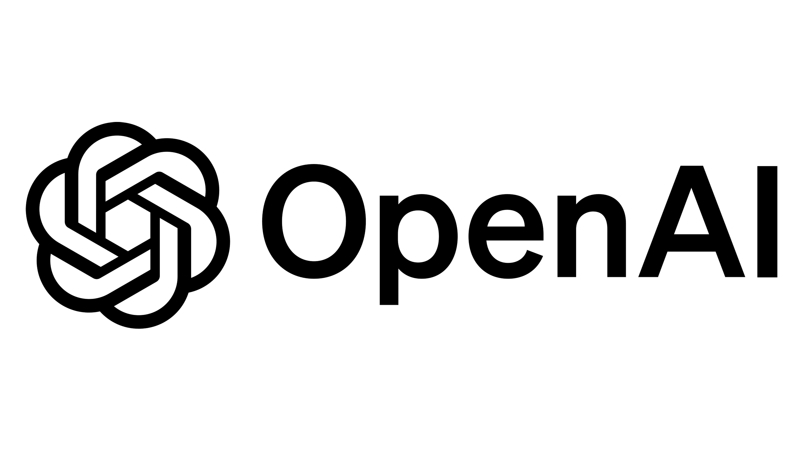





TOOLS AND TECHNOLOGIES

Slide 6
FEASIBILITY AND VIABILITY
FEASIBILITY | VIABILITY
VoIP Integration via Exotel | Phone-call based banking access
Speech-to-Text Processing (AssemblyAI) | Easy API integration with banks
AI Intent Processing (OpenAI) | Uses proven AI voice technologies
Natural Voice Response (ElevenLabs) | Supports multiple languages
Flask-Based Banking Backend | Reduces customer support load
HTTP API Communication | Low-cost cloud deployment
Real-Time Data Processing | Easy adoption for banks
Modular AI Architecture | Scalable user support

Slide 7
IMPACT AND BENEFITS
BEFORE THE SOLUTION | AFTER THE SOLUTION
Language barriers in digital banking services | Voice-based banking through simple phone calls
Difficult navigation for elderly and rural users | Easy conversational interaction in regional languages
Limited access for visually impaired individuals | Accessible banking for visually impaired users
Long waiting time for customer support | Instant AI-powered assistance available 24/7

Slide 8
WHO BENEFITS FROM THIS ?
Rural Communities – Access banking services using voice in their native language
Elderly Users – Simple voice interaction instead of complex mobile apps
Visually Impaired Individuals – Independent banking through voice assistance
Non-English Speakers – Banking support in regional languages
Bank Customers – Faster and easier banking interactions
Banking Institutions – Reduced customer support workload
Customer Support Teams – AI handles repetitive queries
Financial Inclusion Programs – Expands access to digital banking services

Slide 9
IMPACT ON ECONOMY
Increases financial inclusion in rural and underserved regions
Reduces operational costs for banks through AI automation
Decreases manpower requirements in banking call centers
Improves efficiency of customer support services
Encourages adoption of digital and voice-based banking
Supports growth of AI-driven fintech solutions
Enables faster banking services for large populations
Strengthens the digital economy through accessible financial systems

Slide 10
RESEARCH AND REFERENCES
➤ “Conversational AI in Banking and Financial Services” – IEEE Xplore https://ieeexplore.ieee.org/document/9154577
➤ “Speech Recognition Systems for Human–Computer Interaction” – IEEE Transactions on Audio, Speech and Language Processing https://ieeexplore.ieee.org
➤ “Voice Assistants in Financial Services: Opportunities and Challenges” – Springer Research Publications https://link.springer.com
➤ “Natural Language Processing for Financial Applications” – ACM Digital Library https://dl.acm.org
➤ AssemblyAI Speech-to-Text Documentation https://www.assemblyai.com/docs
➤ OpenAI API Documentation https://platform.openai.com/docs
➤ ElevenLabs Text-to-Speech Documentation https://docs.elevenlabs.io
➤ Exotel Voice API Documentation https://developer.exotel.com
➤ Flask Web Framework Documentation https://flask.palletsprojects.com

